Slide 1
Formula 1 racing
Proposal project for :
Tuwaiq_Four_Week
Submitted by:
Mohammed Almatrood

Slide 2
Formula One (also known as Formula 1 or F1)
s the highest class of international auto racing for single-seater formula racing cars sanctioned by the Fédération Internationale de l'Automobile (FIA).

Slide 3
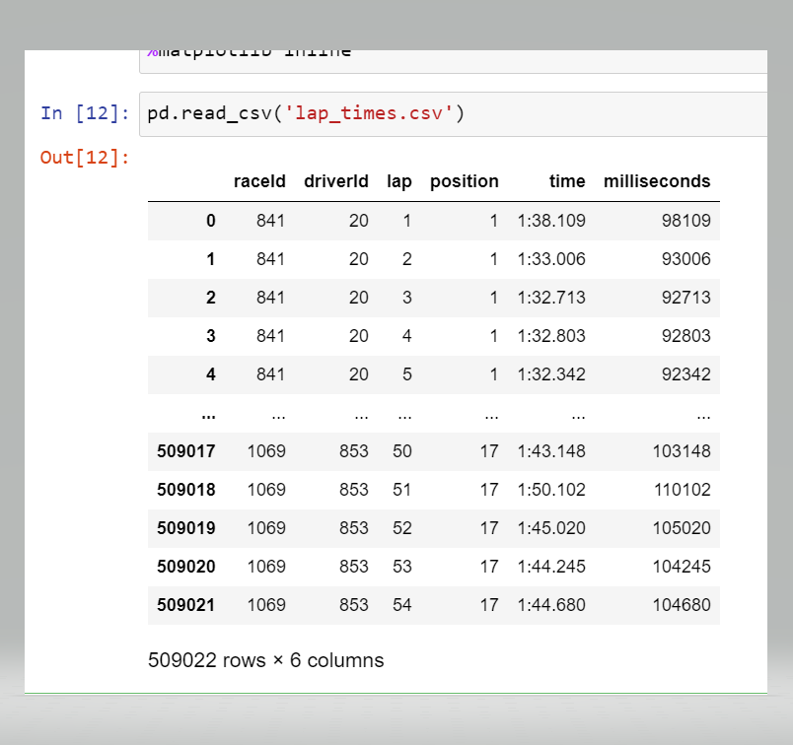
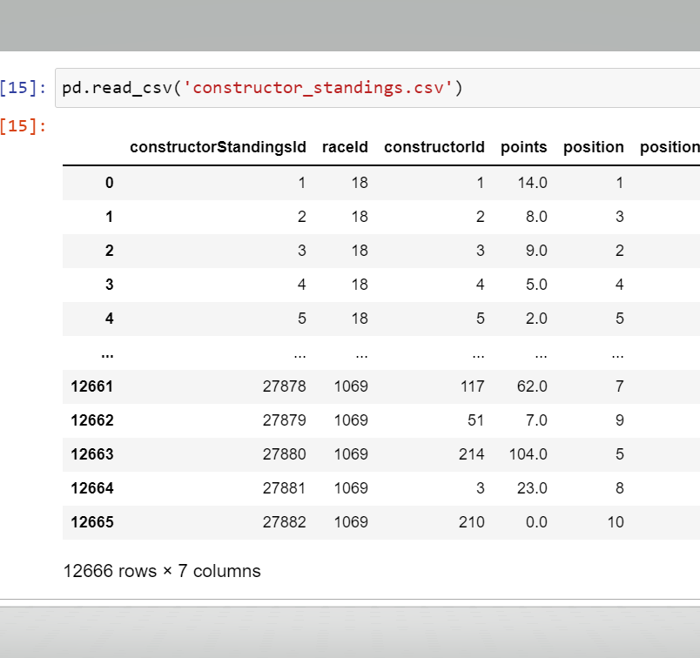
From : Ergast Developer API CSV Database Tables

